Slide 1
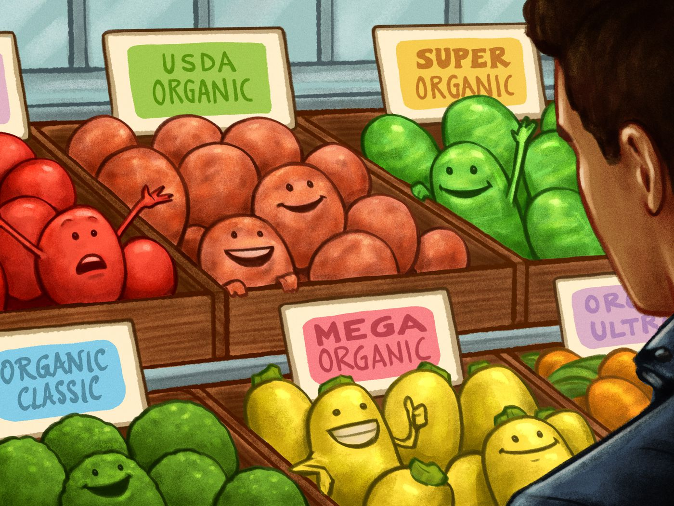
Welcome to Organic Chem
Take out table P + Q now.

Slide 2
All chemistry we have been doing is technically “inorganic” chem.
Organic Chem was once thought to be made up of molecules that could only form from living organisms (plants and animals). They had “the spark of life” and could not be made by scientists.
Humorously (and truthfully) the first organic molecule synthesized was urea. I think that’s funny. Now scientists and college students can make them all. There are billions of possible organic molecules, most have not been made yet.
The organic molecules we will study are more complex than the simpler compounds we have learned about so far, but we get some tables to help.
We use specific rules to name them all. The tables will help us.
Organic chemistry is the class in college that students cry in almost daily.
Especially during exams, I remember it well.
High School organic chem is relatively easy, you shouldn’t cry.

Slide 3
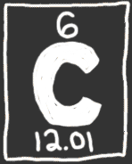
Carbon.
1. Carbon is the atom in all organic molecules.
2. Carbon can make single, double and triple bonds
to other carbon atoms.
3. There are NO METALS in organic chem.
4. Look at table P, fill in the boxes for the prefixes
that indicate how many carbon atoms are in a molecule.
OUR FRIEND

Slide 4
5. Carbon makes 4 bonds because it has a 2-4 electron configuration,
it needs 4e– for an octet, for bonding stability.
6. Carbon atoms make 4 bonds. They can be:
→ 4 single bonds
→ 2 single bonds + 1 double bond
→ 2 double bonds
→ 1 single + 1 triple bond
4 bonds, every time, no matter what.
7. Hydrogen atoms have 1 electron and
can only make a single bond.

Slide 5
8. What is the name and the formula of the
simplest hydrocarbon?
(It has one carbon atom and 4 H atoms)

Slide 6
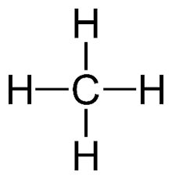
8. What is the name and the formula of the
simplest hydrocarbon?
(It has one carbon atom and 4 H atoms)
CH₄
METHANE

Slide 7
9. Hydrocarbons are the simplest molecules in organic
chem, made up of only hydrogen and carbon atoms.
10. Table Q is titled:
HOMOLOGOUS SERIES OF HYDROCARBONS
11. Homologous HOMO + LOGOUS which means
SAME BODY TYPE

Slide 8
12. The three “body types” or SERIES are |  | Example carbon bonding
ALKANES
ALKENES
ALKYNES

Slide 9
12. The three “body types” or SERIES are |  | Example carbon bonding
ALKANES | Which have ONLY single bonds carbon to carbon | C – C
ALKENES | Which have a double bonded carbon to carbon | C = C
ALKYNES | Which have a triple bonded carbon to carbon | C ≡ C

Slide 10
14. Name the SINGLE BONDED CARBON hydrocarbons 1 to 10 carbons long, draw the structural diagrams and structural formulas, for each.
# C | Name | Structural Diagram | Molecular formula and Condensed structural formula
1
2
3

Slide 11
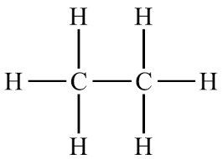
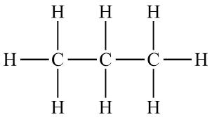
14. Name the SINGLE BONDED CARBON hydrocarbons 1 to 10 carbons long, draw the structural diagrams and structural formulas, for each.
# C | Name | Structural Diagram | Molecular formula and Condensed structural formula
1 | methane |  | CH₄ CH₄
2 | ethane |  | C₂H₆ CH₃CH₃
3 | propane |  | C₃H₈ CH₃CH₂CH₃

Slide 12
14. Name the SINGLE BONDED CARBON hydrocarbons 1 to 10 carbons long, draw the structural diagrams and structural formulas, for each.
# C | Name | Structural Diagram | Molecular formula and Condensed structural formula
4
5
6

Slide 13
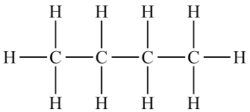
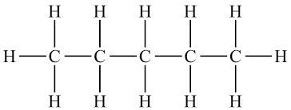
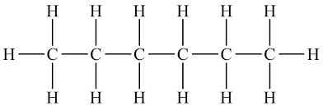
14. Name the SINGLE BONDED CARBON hydrocarbons 1 to 10 carbons long, draw the structural diagrams and structural formulas, for each.
# C | Name | Structural Diagram | Molecular formula and Condensed structural formula
4 | butane |  | C₄H₁₀ CH₃(CH₂)₂CH₃
5 | pentane |  | C₅H₁₂ CH₃(CH₂)₃CH₃
6 | hexane |  | C₆H₁₄ CH₃(CH₂)₄CH₃

Slide 14
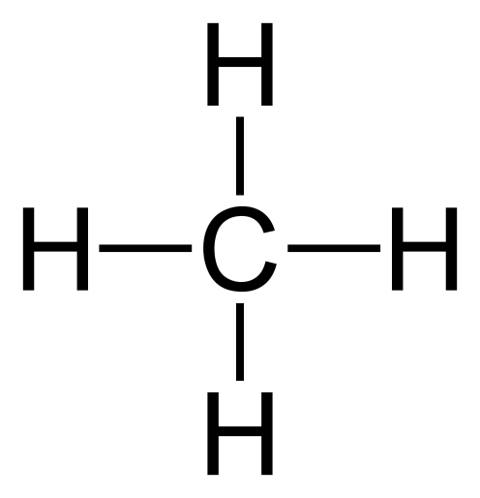
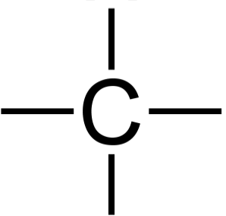
I am already starting to get tired of all the “H” atoms.
How about this, if you’re smart, you can just KNOW that carbon must bond to H, and we’ll agree to draw in each dash representing a bond to a H atom, but we’ll leave the “H” atoms out.
This is always okay, but this is the same thing from now on.

Slide 15
14. Name the SINGLE BONDED CARBON hydrocarbons 1 to 10 carbons long, draw the structural diagrams and structural formulas, for each.
# C | Name | Structural Diagram | Molecular formula and Condensed structural formula
7
8

Slide 16
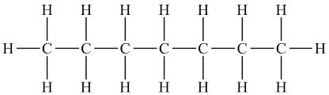
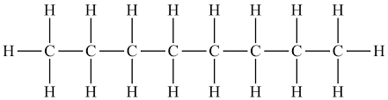
14. Name the SINGLE BONDED CARBON hydrocarbons 1 to 10 carbons long, draw the structural diagrams and structural formulas, for each.
# C | Name | Structural Diagram | Molecular formula and Condensed structural formula
7 | heptane |  | C₇H₁₆ CH₃(CH₂)₅CH₃
8 | octane |  | C₈H₁₈ CH₃(CH₂)₆CH₃

Slide 17
14. Name the SINGLE BONDED CARBON hydrocarbons 1 to 10 carbons long, draw the structural diagrams and structural formulas, for each.
# C | Name | Structural Diagram | Molecular formula and Condensed structural formula
9
10

Slide 18
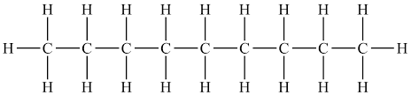
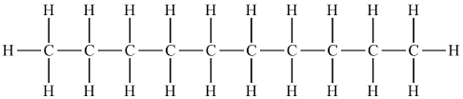
14. Name the SINGLE BONDED CARBON hydrocarbons 1 to 10 carbons long, draw the structural diagrams and structural formulas, for each.
# C | Name | Structural Diagram | Molecular formula and Condensed structural formula
9 | nonane |  | C₉H₂₀ CH₃(CH₂)₇CH₃
7 | decane |  | C₁₀H₂₂ CH₃(CH₂)₈CH₃

Slide 19
Organic Vocabulary
15. Organic chem: chemical compounds that at one time were thought
to be made only by living organisms like plants or animals.
This is not true, nor was it.
16. Carbon: the central atom in organic chem, it makes 4 bonds
because of its electron configuration of 2-4. It can make single or
double or triple bonds to itself.
17. Hydrocarbons: simple molecules in organic chem, made up
only of Hydrogen and carbon atoms, hence the name.
18. Homologous Series of Hydrocarbons (title to Table Q): having the
“same body type” molecules made up of only H + C.
Contain ONLY single bonds, or a double bond, or a triple bond.

Slide 20
19. The first series of Hydrocarbons is ALKANES.
(you just drew all ten of them)
Alkanes have ONLY single bonds between the carbons.
No double bonds or triple bonds allowed.
Their GENERAL FORMULA is
C_{n}H_{2n+2}
Example: The alkane with 4 carbon atoms (butane)
would have 2n+2 hydrogen atoms,
Butane has a molecular formula of C₄H₁₀

Slide 21
20. The 2nd homologous series of hydrocarbons are
called ________.
21. The general formula for alkenes is ____________
They have less H’s than alkanes because of
the double C=C bond.
22. An alkene with 5 carbon atoms has the
molecular formula of __________

Slide 22
20. The 2nd homologous series of hydrocarbons are
called alkenes.
21. The general formula for alkenes is C_{n}H_{2n}
They have less H’s than alkanes because of
the double C=C bond.
22. An alkene with 5 carbon atoms has the
molecular formula of C₅H₁₀

Slide 23
23. In our class alkenes will contain JUST ONE
double bond, but in the real world, multiple
double bonds are possible in one molecule.
24. Methene is NOT possible because in order to
have a double bond between 2 carbon atoms
you need 2 carbon atoms. Meth = 1 carbon

Slide 24
25. Draw ethene | Draw propene to the left | Draw propene to the right.

Slide 25
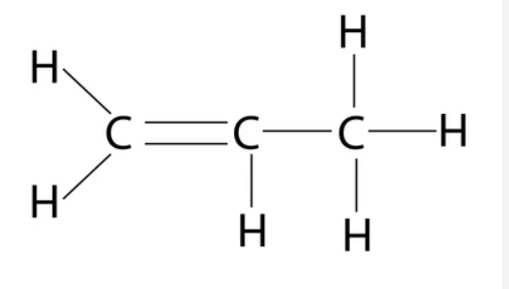
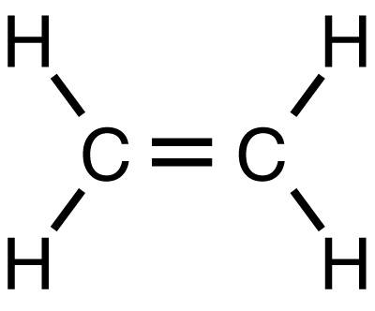
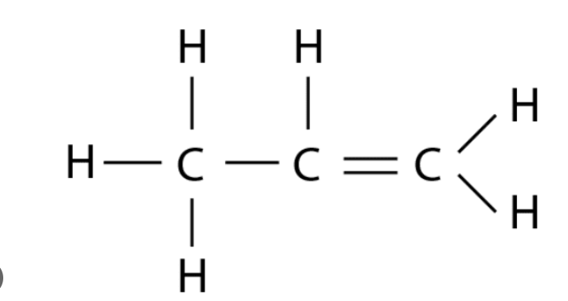
25. Draw ethene | Draw propene to the left | Draw propene to the right.
Ethene Hydrogen atoms at an angle is cool, or you can stick with the 90° angles, it’s just a drawing. | Propene Double bond to the left side is the same thing as to the right side. | Propene Double bond to the right side is the same thing as to the left side.
26. Both propene molecules are identical.
There is no “left or right”. Molecules turn in space.

Slide 26
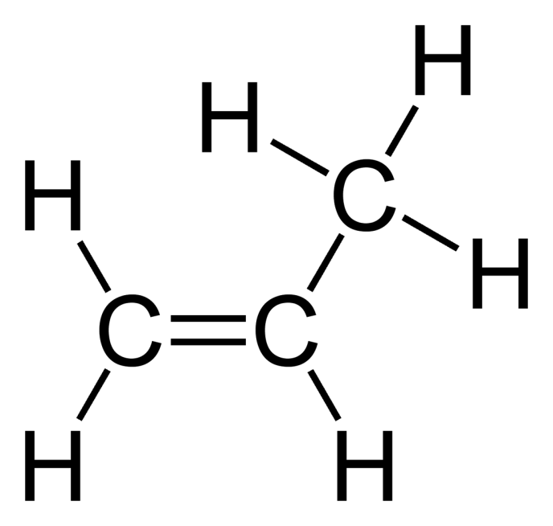

Propene
Straight lines, or bent:
the chain is 3 carbons single bonded, in a row.
That’s all that matters.

Slide 27
27. Draw butene.

Slide 28
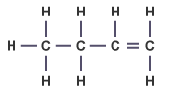
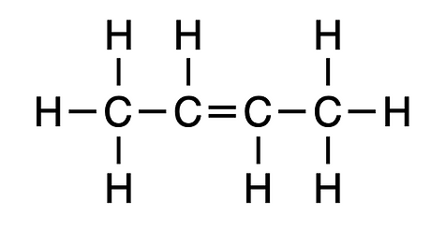
27
28 | 1-butene | 2-butene
29 | CH₃CH₂CHCH₂ | CH₃CHCHCH₃
30 | Isomers share a Molecular Formula: C₄H₈ but have different structural formulas and different properties.

Slide 29
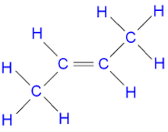
This is also 2-butene,
but with a bit more style.
Unnecessary but
not incorrect.
FOUR CARBONS
with a double bond from
the 2nd to 3rd carbon atom.
Molecular Formula: C₄H₈
Condensed structural formula: CH₃CHCHCH₃

Slide 30
 | Draw these molecules next
31 | 1-pentene
32 | 2-pentene

Slide 31
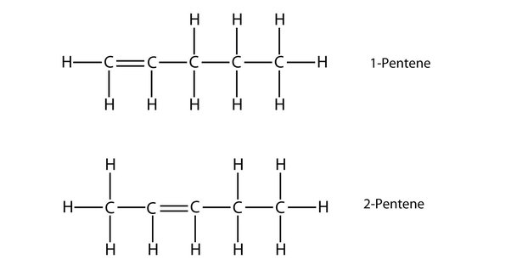
 | Draw these molecules next
31
32
1-pentene
These are isomers
C₅H₁₀
2-pentene

Slide 32
 | Draw these molecules next
33 | 1-hexene
34 | 3-hexene

Slide 33
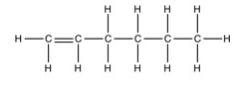
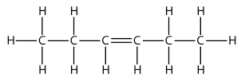
 | Draw these molecules next
33
34
1-hexene
These are isomers
C₆H₁₂
3-hexene

Slide 34
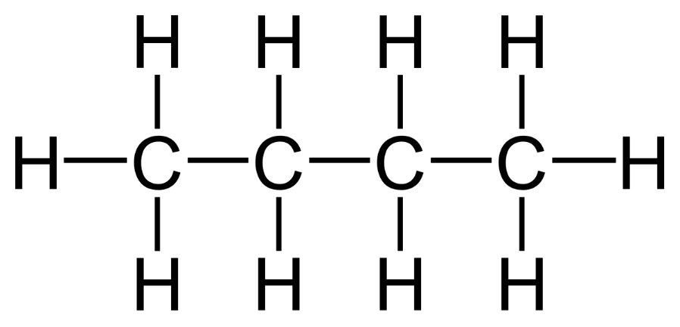
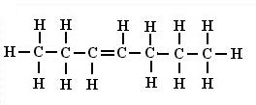
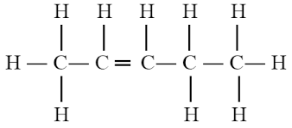
Name these (bad boys) big molecules…
35
36
37
=

Slide 35
Name these (bad boys) big molecules…
35
36
37
=
35. 2-octene
36. 3-heptene
37. 2-pentene

Slide 36
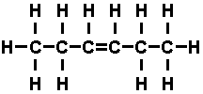
38. Name and write the condensed structural formulas for this
39. Name and write the condensed structural formulas for this
=

Slide 37
38. CH₃CH₂CHCHCH₂CH₃ or CH₃CH₂(CH)₂CH₂CH₃
3-hexene
39. CH₃CHCHCH₂CH₂CH₂CH₂CH₃ or CH₃(CH)₂(CH₂)₄CH₃
2-octene
=

Slide 38
40. The 3rd group of hydrocarbons are the ALKYNES
That’s a small change in the name.
In our class ALKYNES only have one triple bond.
Naming and drawing will be just like the alkenes,
the number tells where the triple bond is placed.
41. There is no “methyne” -- you need at least two
carbon atoms to triple bond together.

Slide 39
42. Draw ethyne

Slide 40

42. Draw ethyne
Ethyne has one triple bonded carbon pair.

Slide 41
43. Draw propyne

Slide 42
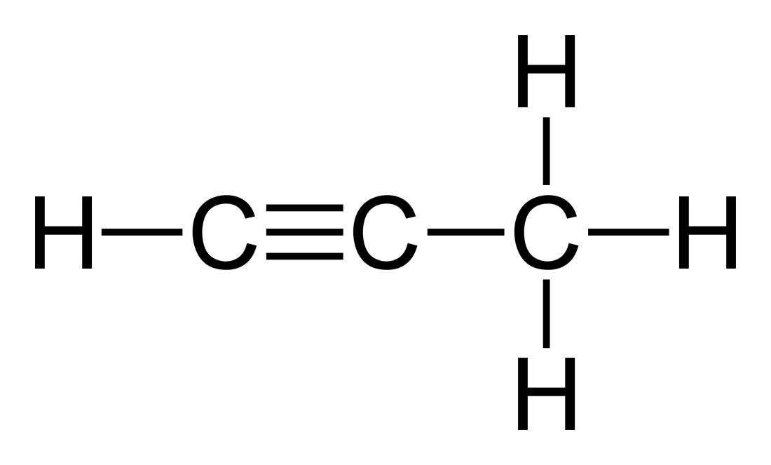
43. Draw propyne.
Propyne has one triple bonded carbon pair also.

Slide 43

44. Let’s draw 1-butyne

Slide 44
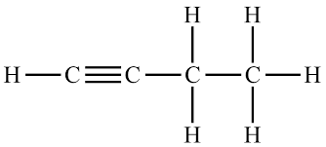
44. Let’s draw 1-butyne
That’s 1-butyne, counting from the left side.
Don’t count from the right!
Just keep track of where
the “first” carbon is, on the left or right, choose the “lower number”.

Slide 45
45. Draw 2-butyne

Slide 46
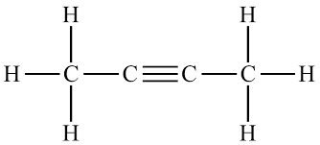
45. Draw 2-butyne
This is 2-butyne
The triple bond is between carbon 2 – 3
counting from
EITHER direction.

Slide 47
45. Draw 2-butyne
That’s 1-butyne at left.
counting from the right side.
Just keep track of the “first” carbon, left/right doesn’t matter.

Slide 48
46. Let’s draw some more…
1-pentyne
2-pentyne
1-heptyne
3-heptyne

Slide 49
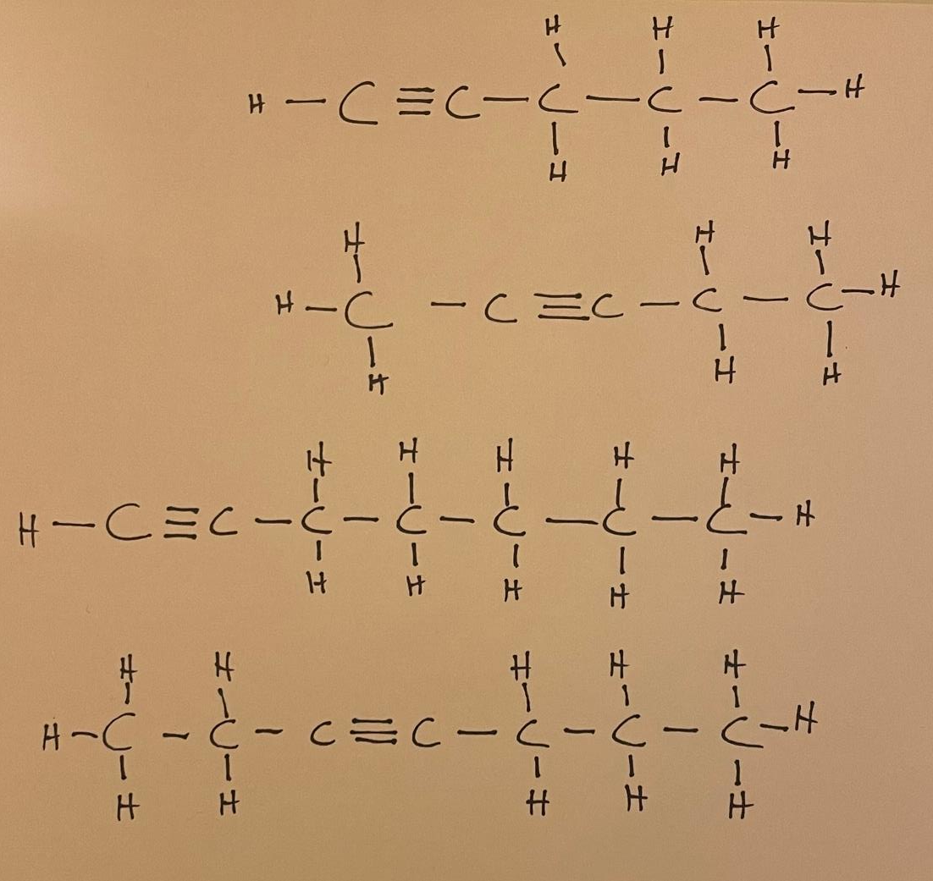
46. Let’s draw some more…
1-pentyne
2-pentyne
1-heptyne
3-heptyne

Slide 50
47. What is the general formula for alkynes?
If an alkyne has 9 carbons, what is the formula?

Slide 51
47. What is the general formula for alkynes?
C_{n}H_{2n-2}
If an alkyne has 9 carbons, what is the formula?
C₉H₁₆
stop

Slide 52

Organic Chem Class #3
Objective: How to add halogens into all three kinds
of hydrocarbons.
Take out Table R
Why do Pirates Love Organic Chem?

Slide 53
Organic Chem Class #3
Objective: How to add halogens into all three kinds
of hydrocarbons.
Take out Table R
Why do Pirates Love Organic Chem?
They really like table ARRRRGGHHHHH!

Slide 54
48. Table R lists all FUNCTIONAL GROUPS
49. Functional groups are added to hydrocarbons to
make them fancier, to make them more difficult,
to make them smell better or worse,
to give them a wide variety of new properties.
The first, functional group we will add to
hydrocarbons are the halogens

Slide 55
 | HALOGENS | symbols | Organic Chem Prefix names
50 |  | F
51 |  | Cl
52 |  | Br
53 |  | I

Slide 56
 | HALOGENS | symbols | Organic Chem Prefix names
50 | fluorine | F | fluoro
51 | chlorine | Cl | chloro
52 | bromine | Br | bromo
53 | iodine | I | iodo

Slide 57
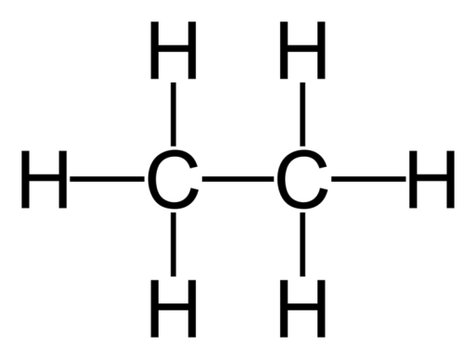
54. Draw then name these molecules now.
Br
Cl

Slide 58
54. Draw then name these molecules now.
Br
Cl
Bromo-ethane
Chloro-ethane

Slide 59
55. Let’s name these molecules now.
F
F F
F

Slide 60
55. Let’s name these molecules now.
F
F F
F
1,2 di-fluoro-ethane
1,1 di-fluoro-ethane

Slide 61
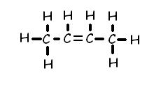
56. Draw and name this molecule.
Cl
Cl
First: Name the “base chain”,
then we’ll figure out the first name after.

Slide 62
56. Draw and name this molecule.
Cl
Cl
The base chain is a 2-butene.
Four carbon atoms, the double bond is between #2 and #3
Chlorine at the #2 carbon, and # 4 carbon atoms.
This is 1,3 dichloro 2pentene.

Slide 63
56. Draw and name this molecule.
Cl
Cl
The base chain is a 2-butene.
Four carbon atoms, the double bond is between #2 and #3
Chlorine atoms at the #2 carbon, and # 4 carbon atoms, so…
1,3 dichloro 2pentene.

Slide 64
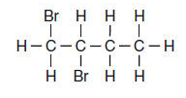
57. Let’s name this molecule.

Slide 65
1,2 dibromo butane
57. Let’s name this molecule.

Slide 66
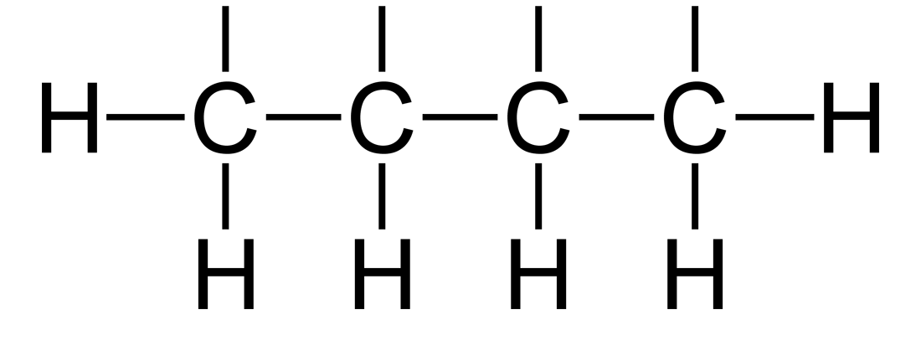
The rules to naming these halo-carbons is easy
58a. NAME the base chain name, the “LAST NAME” of the molecule.
58b. A Double or Triple bonds sets the carbon atom count;
The halogens get numbered based on the carbon atom count.
58c. If you have no double or triple bond, set the carbon count with
the LOWEST number combination.
58d. The halogens are numbered but they are named in
ALPHABETICAL order.
H Br F F
59. Draw & name
this molecule

Slide 67
59. Draw & name this molecule
H Br F F
4 carbon atoms, all single bonded. Last name = butane.
Count right to left, lowest numbers are correct.
Alphabetical on the halogens.
3-bromo,1,2-difluoro butane
(3+1+2 = 6)
WRONG: Named backwards would be 2 bromo, 3,4 difluoro butane. (2+3+4 = 9)

Slide 68
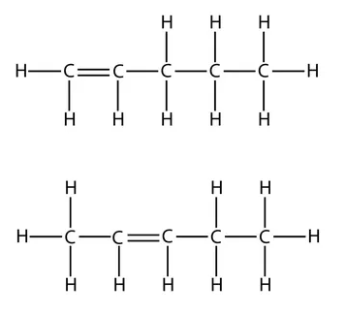
60. Draw and name these.
Br
Br
I
I
I

Slide 69
60. Draw and name these.
2,5 dibromo-1pentene
Br
Br
I
I
I

Slide 70
60. Draw and name these.
2,5 dibromo-1pentene
Br
Br
1,4,4 tri-iodo 2pentene
I
I
I

Slide 71
61. Draw the next 3 molecules
1,1dibromo-2,2 difluroethane
difluoroethyne
5bromo-4,4 dichloro-7,8,8trifluoro-1,2,3,7 tetra-iodo-1octene

Slide 72
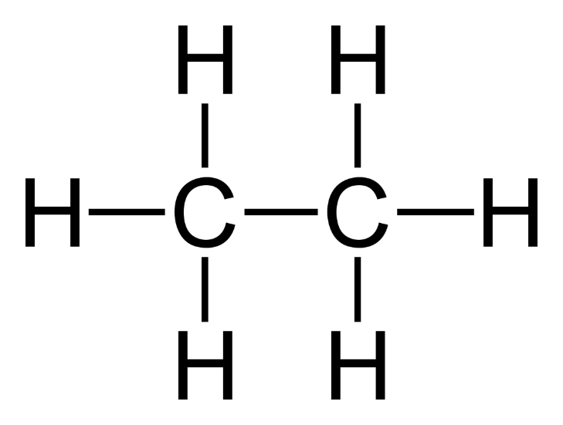
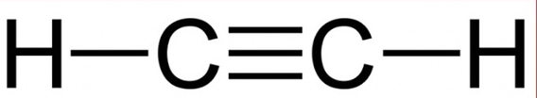
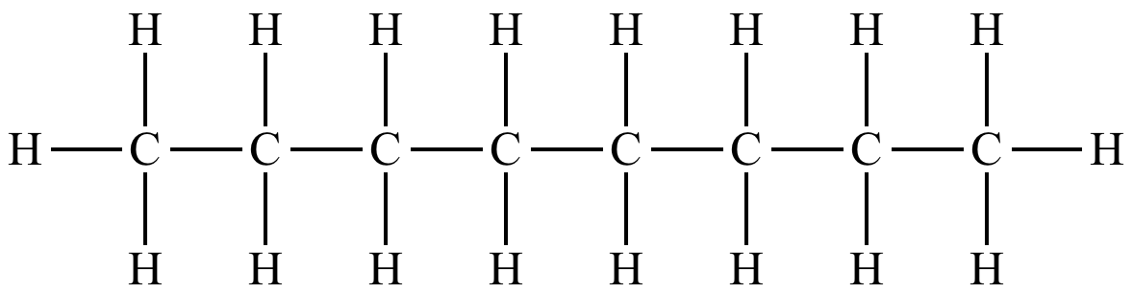
61. Draw the next 3 molecules
1,1dibromo-2,2 difluroethane
difluoroethyne
5bromo-4,4 dichloro-7,8,8trifluoro-1,2,3,7 tetra-iodo-1octene
Br
F
Br
F
F
F
Cl
F
F
I
I
I
Cl
Br
I
F

Slide 73
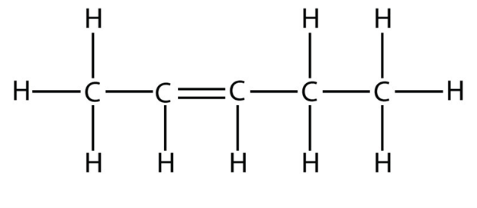
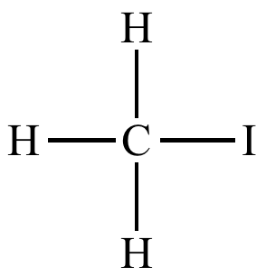
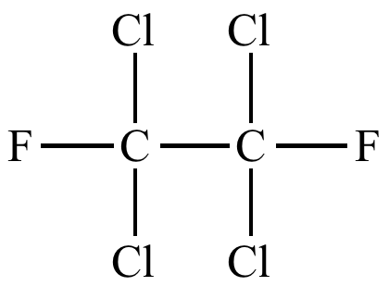
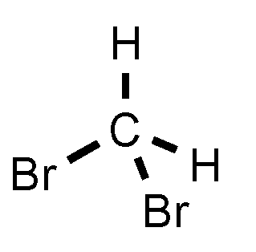
62. Name these…
These are not in the same place on your page.
Br
Br
F
F
Cl
Cl
F
F
Br

Slide 74

Iodomethane
1,1,2,2tetrachloro-1,2difluoroethane
F
F
Br
Br
F
2pentene
dibromomethane
Br
Br
F
1,6,8 tribromo
2,4 dichloro-6,7,8,8 tetrafluoro
octane
F
Cl
Cl
F
F
Br

Slide 75
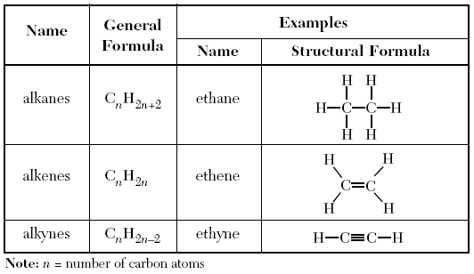
63. Take out Table Q, we need to “fix” it.
You write the blue text…
Kind of alkane
Saturated
Unsaturated
Unsaturated
REACTIONS
Substitution
Addition
Addition

Slide 76
All the example hydrocarbons in table Q
have 2 carbon atoms each.
64. Alkanes are SATURATED
these 2 carbon atoms can “hold” the most
hydrogen atoms = 6 H,
because they only have SINGLE BONDS.

Slide 77
All the example hydrocarbons in table Q
have 2 carbon atoms each.
64. Alkanes are SATURATED
these 2 carbon atoms can “hold” the most
hydrogen atoms = 6 H,
because they only have SINGLE BONDS.
65. Alkenes and Alkynes are UNSATURATED
these have a double or triple bond, so the “hold”
less hydrogen atoms (4 H or 2 H) than alkanes.

Slide 78
66. Alkanes are saturated,
they can’t be “added” to.
67. Alkanes can undergo
substitution reactions only.
(but not addition reactions).
68. Alkenes and Alkynes are unsaturated,
they undergo addition reactions only.
(but not substitution reactions).

Slide 79
69. Substitute in fluorine to ethane in a substitution reaction.
+ F₂
Ethane + Fluorine →

Slide 80
69. Substitute in fluorine to ethane in a substitution reaction.
+ F₂
F + HF
Ethane + Fluorine → Fluoro-ethane + hydrogen monofluoride

Slide 81
70. Show the propane + iodine undergo
a substitution reaction
(our choice here is to substitute onto the central carbon atom)

Slide 82
70. Show the propane + iodine undergo
a substitution reaction
(our choice here is to substitute onto the central carbon atom)
+ I₂ →
+ HI
I
2-iodopropane
and
hydrogen monoiodide
are the products.

Slide 83
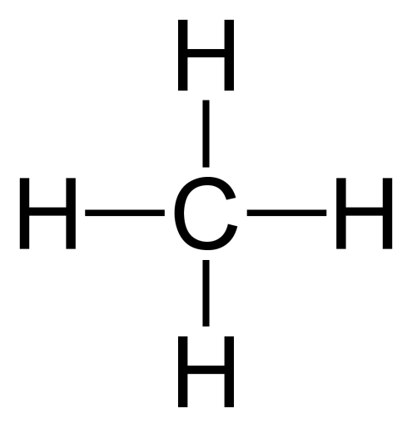
71a. Multiple substitution reactions with
saturated methane and chlorine.
+ Cl₂
Cl + HCl
Methane + chlorine → chloromethane + HCl

Slide 84
71b. Multiple substitution reactions with
saturated methane and chlorine.
Cl + Cl₂
Chloromethane + chlorine makes

Slide 85
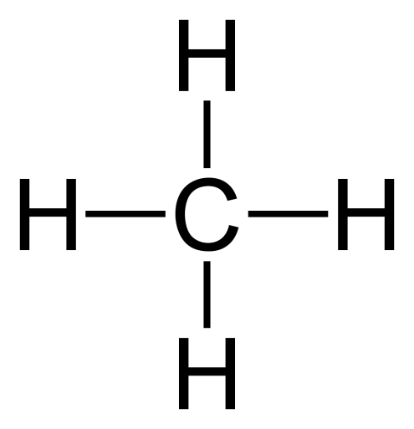
71b. Multiple substitution reactions with
saturated methane and chlorine.
Cl + Cl₂
Cl + HCl
Cl
Chloromethane + chlorine makes dichloromethane + HCl

Slide 86
71c. Multiple substitution reactions with
saturated methane and chlorine.
Cl + Cl₂
Cl
Dichloromethane + chlorine →

Slide 87
71c. Multiple substitution reactions with
saturated methane and chlorine.
Cl
Cl + Cl₂
Cl + HCl
Cl
Cl
Dichloromethane + chlorine → trichloromethane + HCl

Slide 88
71d. Multiple substitution reactions with
saturated methane and chlorine.
Cl
Cl + Cl₂
Cl
Trichloromethane + chlorine →

Slide 89
71d. Multiple substitution reactions with
saturated methane and chlorine.
Cl
Cl
Cl + Cl₂
Cl
Cl + HCl
Cl
Cl
Trichloromethane + chlorine → Tetrachlormethane & HCl
This is the organic name. You could also call this carbon tetrachloride, same thing.

Slide 90
72. Halogens can be substituted into
saturated hydrocarbons, alkanes.
73. It happens ONE HALOGEN AT A TIME.

Slide 91
74. When you combine halogens with
unsaturated hydrocarbons (alkenes/alkynes)
a different reaction happens called an
ADDITION REACTION
That’s because when the double bond “opens up”
to a single bond, and it opens up 2 spots
for BOTH halogens to join the molecule,
or, a triple bond opens up into a double bond,
and again, you ADD both halogens at once.

Slide 92
75. Addition reactions…
Ethene + Bromine →
(unsaturated hydrocarbon + halogen…)

Slide 93
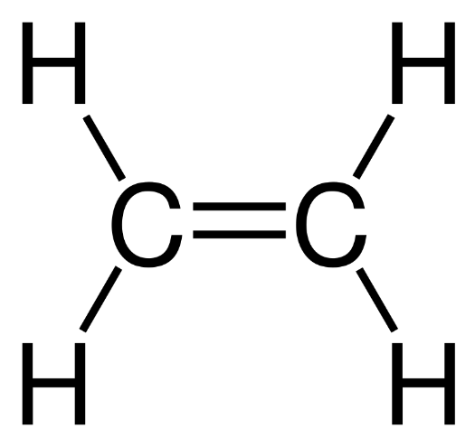
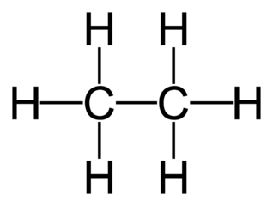
75. Addition reactions…
Ethene + Bromine →
(unsaturated hydrocarbon + halogen…)
+ Br₂ →
Br
Br
1,2 dibromoethane

Slide 94
76. Addition reactions…
2-pentene + fluorine →
(unsaturated hydrocarbon + halogen…)

Slide 95
76. Addition reactions…
2-pentene + fluorine →
(unsaturated hydrocarbon + halogen…)
+ F₂ →
F F
2,3 difluoro pentane

Slide 96
77. Addition reactions…
Ethyne + chlorine →
(unsaturated hydrocarbon + halogen…)

Slide 97
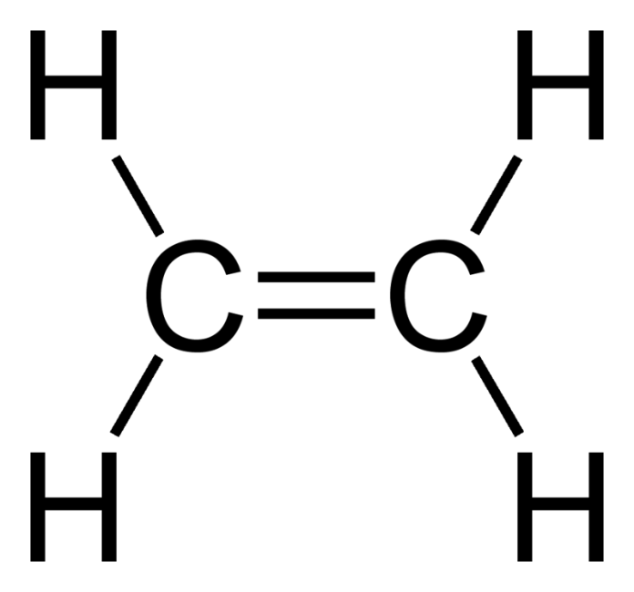

77. Addition reactions…
Ethyne + chlorine →
(unsaturated hydrocarbon + halogen…)
+ Cl₂ →
Cl
Cl
1,2 dichloro ethene

Slide 98
78. Addition reactions…
1-pentyne + iodine →
(unsaturated hydrocarbon + halogen…)

Slide 99

78. Addition reactions…
1-pentyne + iodine →
(unsaturated hydrocarbon + halogen…)
Product is
1,2 di-iodo
1-pentene

Slide 100

Alcohols & Ethers
79. Draw their functional groups
(column 2 only)

Slide 101
Alcohols
80. Alcohols have an “–OH” group which is
NOT a hydroxide.
Alcohols are MOLECULAR not ionic.
When the hydroxide anion is ionically bonded
to a metal, that’s an Arrhenius base. (NaOH, or KOH)
Alcohols are not bases.

Slide 102
83. Draw METHANOL (one carbon alcohol)
and then ETHANOL (2 carbon alcohol)

Slide 103


83. Draw METHANOL (one carbon alcohol)
83. Draw METHANOL (one carbon alcohol)
and then ETHANOL (2 carbon alcohol)
Notice the – OH functional group.
These are NOT ionic, they are molecular.

Slide 104

83. Write the condensed structural formulas for both of
these alcohol molecules.
CH₃OH
methanol
The –OH really means
–O–H
But we abbreviate it and just “know” that the oxygen and hydrogen make a single covalent bond.
It’s prettier that way.
CH₃CH₂OH
ethanol

Slide 105
84. Draw ethanol two times, once with the “–OH”
group on the right side, once on the left bottom.

Slide 106

84. Draw ethanol two times, once with the “–OH”
group on the right side, once on the left bottom.
These are identical.
The alcohol group is on the #1 carbon
in both molecules.

Slide 107
85. Draw both propanol molecules, one with the –OH group
on the 1st carbon atom, then put it onto the 2nd carbon
atom. Name both.

Slide 108


85. Draw both of the propanol molecules, one with the
–OH group on the first carbon atom, then put it onto
the second carbon atom. Name both.
1-propanol 2-propanol
86. These are different ISOMERS, which means they have the same chemical formula (C₃H₈O), but different structures. They are not identical.

Slide 109
87. Draw & name the three 5 carbon alcohol molecules

Slide 110
87. Draw & name the three 5 carbon alcohol molecules
H H H H H
Name the base chain (count carbon atoms)
Enumerate where the alcohol group is located.
Alcohol names always end with an
-anol
suffix
H
1-pentanol
C
C
C
C
C
OH
H H H H H
H H H H H
2-pentanol
H
C
C
C
C
C
H
H H H OH H
H H H H H
3-pentanol
H
C
C
C
C
C
H
H H OH H H

Slide 111
88. These are ALL the alcohols in our class, none are missing.
# C atoms names of the alcohol molecules
1 methanol
2 ethanol
3 1-propanol, 2-propanol
4 1-butanol, 2-butanol
5 1-pentanol, 2-pentanol, 3-pentanol
6 1-hexanol, 2-hexanol, 3-hexanol
7 1-heptanol, 2-heptanol, 3-heptanol, 4-heptanol
8 1-octanol, 2-octanol, 3-octanol, 4-octanol
9 1-nonanol, 2-nonanol, 3-nonanol, 4-nonanol, 5-nonanol
10 1-decanol, 2-decanol, 3-decanol, 4-decanol, 5-decanol

Slide 112
89. Why is there not an alcohol molecule named 4-pentanol?
(Draw it, you can)

Slide 113

89. Why is there not an alcohol molecule named 4-pentanol?
(Draw it, you can)
H H H OH H
2 3 4 5 RIGHT?
No! Count from the short end!
This is 2-pentanol

Slide 114
Ethers
Ether molecules are easy to recognize because they have a single atom of oxygen in the middle, and make single bonds left and right
90. Ethers functional group looks like this: –– O ––
91. and a general formula that looks like this: R–– O ––R’
92. Which means an R group is attached to an oxygen atom,
which has a different R prime group on the other side.

Slide 115
Let’s first see about these “R” groups.
They are just hydrocarbon chains,
of one to 10 carbon atoms long.
In high school they are only simple
“alkane-like” chains, nothing fancy,
only single bonds.

Slide 116

93. Draw…Methane is CH₄
You can’t “ADD” a methane to an oxygen in an ether. There is no place for the oxygen to bond.
Methane Methyl
But if we remove a hydrogen atom, we can attach what’s
left of it to the oxygen atoms.

Slide 117



94 - 95
Ethane Ethyl
Propane Propyl

Slide 118
96
Butane
becomes
Butyl

Slide 119
97. And then would come…
Pentane… pentyl Hexane… hexyl
Heptane… heptyl Octane… octyl
Nonane… nonyl Decane… decyl

Slide 120
98. Draw these ethers:
Methyl ethyl ether
Propyl butyl ether
Pentyl methyl ether

Slide 121
98. Draw these ethers:
Methyl ethyl ether
Propyl butyl ether
Pentyl methyl ether
O
O
O

Slide 122
99. Draw these ethers too:
Diethyl ether
Dimethyl ether
Hexyl ethyl ether

Slide 123


99. Draw these ethers too:
Diethyl ether
Dimethyl ether
Hexyl ethyl ether
O
Only a goof ball
would say
ethyl ethyl
or
methyl methyl
O
O

Slide 124
100. THINK, In OUR high school chem class…
What’s the smallest possible ether?
What’s the biggest ether?
What is the 2d biggest ether?
Can there be double bonds, or triple bonds in our ethers?
Can there be alcohols or halogens be attached to our ethers?
Can there be two functional groups right next to each other?
Can there be 2 or more alcohol groups on one molecule?

Slide 125
100. THINK, In OUR high school chem class…
What’s the smallest possible ether? Dimethyl ether
What’s the biggest ether? Didecyl ether
What is the 2d biggest ether? Nonyl decyl ether
Can there be double bonds, or triple bonds in our ethers? Never
Can there be alcohols or halogens be attached to our ethers? Nope
Can there be two functional groups right next to each other? No, no, no
Can there be 2 or more alcohol groups on one molecule? Stop, no!

Slide 126

101. Aldehydes + Ketones we will examine together, since they are nearly the same thing.
When they both have the same number of carbon atoms, they are ISOMERS.
102. Both have a C=O bond, just in different places.
Add this red & blue and that box at left into your table R now
END
Isomers
MIDDLE

Slide 127
103. Aldehydes always have the C=O at the
end of a hydrocarbon chain.
Write: R–CHO
104. Ketones always have the C=O in the
middle of a hydrocarbon chain.
Write R–CO–R’
O
R — C —H
O
R — C — R’

Slide 128
105. Draw & name the 3-carbon aldehyde,
and the 3-carbon ketone now

Slide 129


105. Draw & name the 3-carbon aldehyde,
and the 3-carbon ketone now
3 carbon aldehyde propanal
CH₃CH₂CHO
3 carbon ketone propanone
CH₃COCH₃

Slide 130
106. Draw
METHANAL
ETHANAL
BUTANAL
BUTANONE
2-PENTANONE
3-PENTANONE

Slide 131
METHANAL ETHANAL
BUTANONE
BUTANAL
3-PENTANONE
2-PENTANONE
O
O
H
H
C
H
H
C
C
H
H H O H
H
H
C
C
C
C
H
H H H
H H H O
H H O H H
H
C
C
C
C
H
H
C
C
C
C
C
H
H H H
H H H H
H H H O H
H
C
C
C
C
C
H
H H H H

